Slide 1
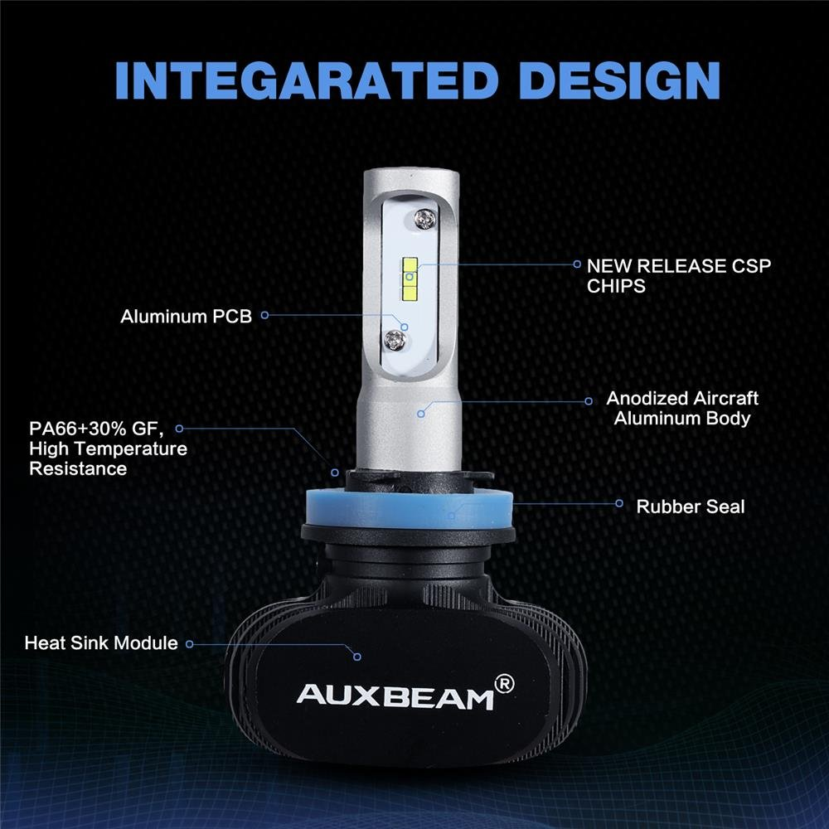
EXPERTBEAM LED Headlight Bulbs S1 Series LED Headlights, with KOREAN CSP LED chips---high Optical density & low heat resistance, enhance light efficiency up to 95%
Fan-less design without ballast, no noise caused by fan.
Spread soft white light on road evenly without dark spot/foggy light, will not dazzle on-coming traffic.
6500K white light show all weather road situation clearly without glare.
Advanced heat conduction system+unique grooved heat sink fins keep the light bulb in appropriate working temperature. Constant current instant start up, no circuit interference and electromagnetic radiation.

Slide 2
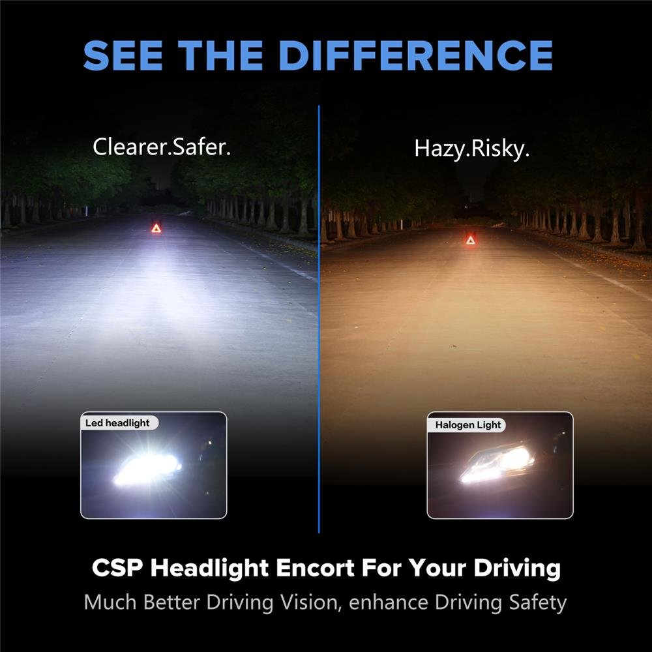
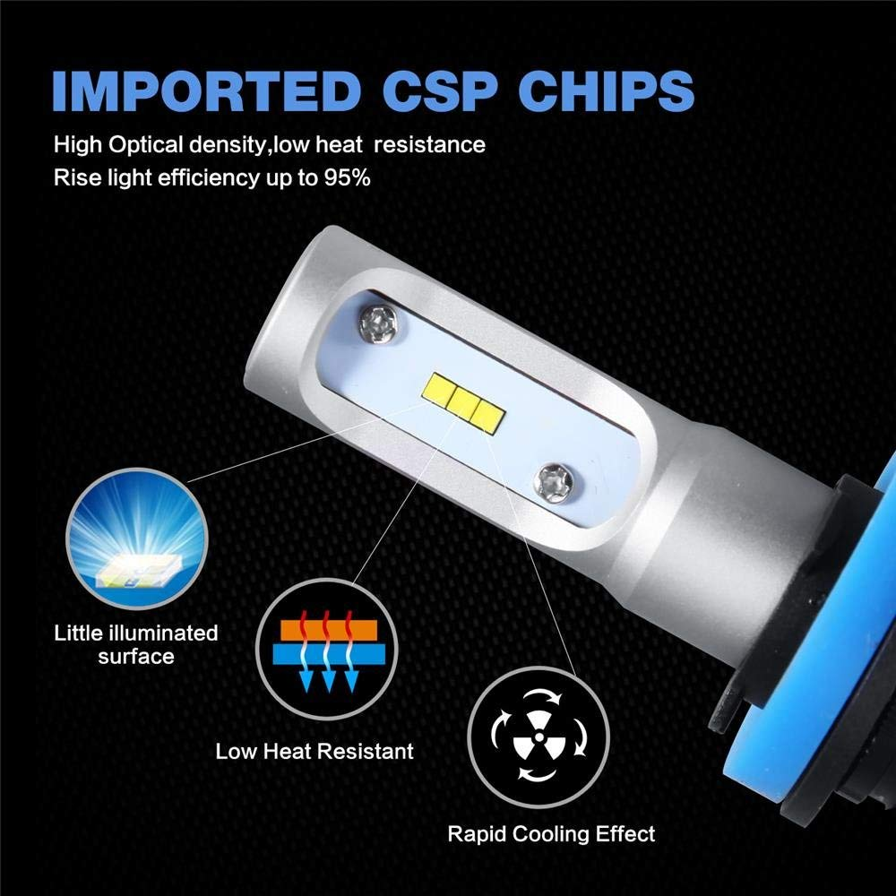
With CSP LED chips from world-leading brand, excellent beam intensity without black spot. Application for headlight, fog light, replace for Halogen, HID Headlights.
6500k White Color with 8000lm low beam and 8000lm high beam (2pcs/set) increase a high and clear performance while you driving across darkness.
Fully co-work with reflector, 360 degree beam increases 30% effective range than other LED light bulb. Superior optic control on road for optimal beam pattern to see the road condition clearly

Slide 3
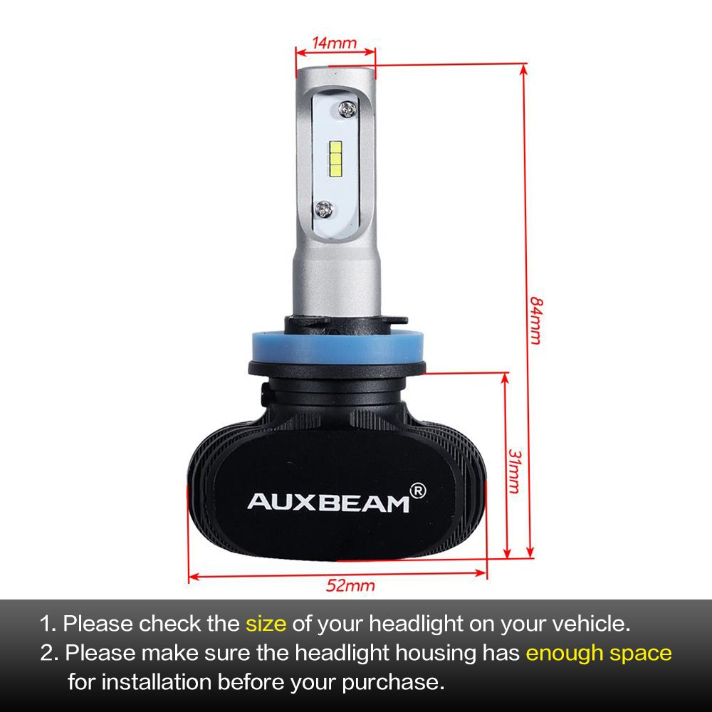
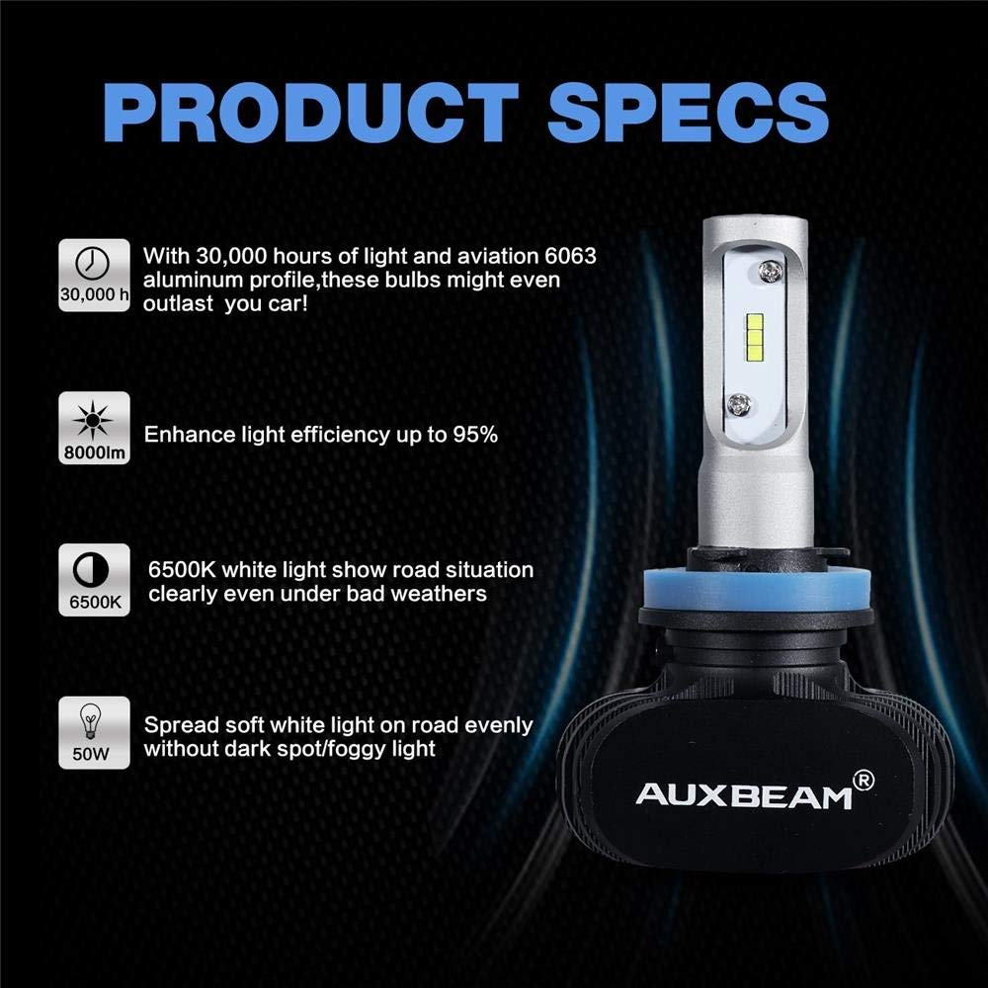
Working under temperature -40℃～+80℃ degree Celsius for a 30,000 hours life time, with rubber ring seals, shock resistant, the only moving part works underwater, cooling lasts even in harsh conditions. S1 LED headlight bulbs conversion kits to offer you a clear view sight and feel safety, you can use it freely in heavy rain.

Slide 4
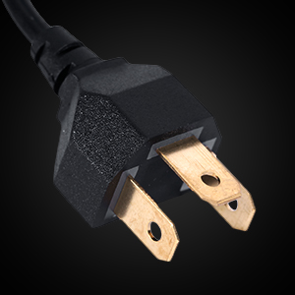
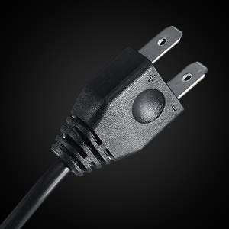
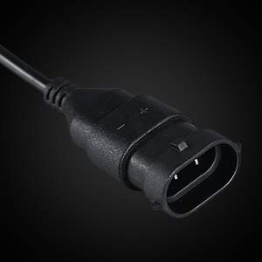
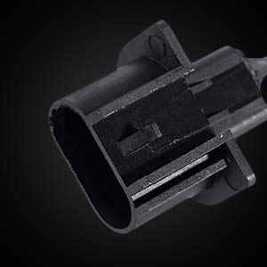
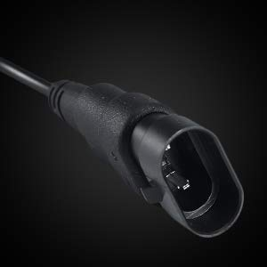
H4
H7
H11
H13
9008
9005
To fit your stock headlights and plug directly into your OEM sockets, please check the plug type of your headlight on your vehicle, whether your vehicle requires a set of warning canceller to prevent on-dash errors.

